Slide 1
Array [2-Dimensional] & String
Course Code: CSC 1102
Course Title: Introduction to Programming (Theory)
Dept. of Computer Science
Faculty of Science and Technology
Lecturer No: | 7 | Week No: | 9 | Semester: | Spring 22-23
Lecturer: | Syeda Nishat Tasnim

Slide 2
Lecture Outline
Array [2-Dimensional]
Definition, Structure & Declaration
Initialization
Access
Memory Access
String
Definition & Structure
Declaration & Initialization
Access, Input, Output
String Handling Functions
Books
References

Slide 3
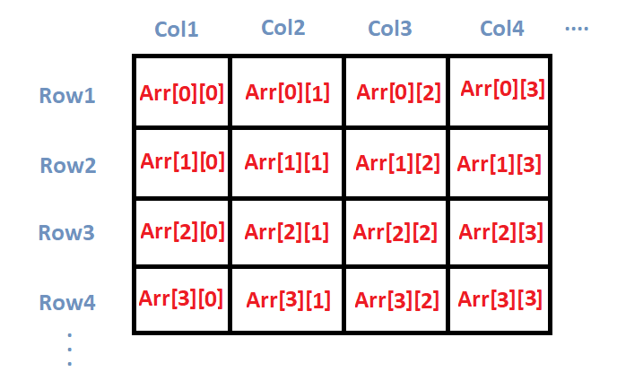

Slide 4
Array [2-Dimensional]
Definition, Structure & Declaration
Two-dimensional arrays can be described as "arrays of arrays". For example, a 2D array can be imagined as a Two-dimensional table made of elements of same uniform data type.
minu represents a Two-dimensional array of 3 per 5 elements of type int. The way to declare this array in C++ would be: int minu [3][5];
The way to reference the 2nd element vertically and 4th horizontally or the (2 × 4) 8th element in an expression would be: minu [1][3];
Generally, for two-dimensional array, 1st dimension is considered as row and the 2nd dimension is considered as column. Here, we have 3 rows and 5 columns.
minu | { |  | 0 | 1 | 2 | 3 | 4
 |  | 0 | minu[0][0] | minu[0][1] | minu[0][2] | minu[0][3] | minu[0][4]
 |  | 1 | minu[1][0] | minu[1][1] | minu[1][2] | minu[1][3] | minu[1][4]
 |  | 2 | minu[2][0] | minu[2][1] | minu[2][2] | minu[2][3] | minu[2][4]

Slide 5
Initialization
Assigning values at the time of declaring a two-dimensional array can be any one of the following ways:
int minu[3][5] = {1,2,3,4,5,2,4,6,8,10,3,6,9,12,15};
int minu[3][5] = {{1,2,3,4,5},{2,4,6,8,10},{3,6,9,12,15}};
int minu[3][5] = {
{1,2,3,4,5},
{2,4,6,8,10},
{3,6,9,12,15}
};
The internal braces are unnecessary, but helps to distinguish the rows from the columns.
Take care to include the semicolon at the end of the curly brace which closes the assignment.
If there are not enough elements in the curly braces to account for every single element in an array, the remaining elements will be filled out with garbage/zeros.
Static and global variables are always guaranteed to be initialized to zero anyway, whereas auto or local variables are guaranteed to be garbage.

Slide 6
Access
Nested loop is used to take input and give output.
The input is taken in row (1st dimension) major. i.e. all the values of row 0 is scanned first, then the values of row 1, and values of row 2. For each row, value at column 0 is scanned first, then the value at column 1, and value at column 2.
In output, array a is used in row major. But array b is used in column (2nd dimension) major. i.e. all the values of column 0 is added first, then the values of column 1, and values of column 2. For each column, value at row 0 is added first, then the value at row 1, and value at row 2.
Consider the following example (the dark area at the end consists the input and the output of this program; the yellow colored text represents input given by the user and black colored text represents output):
1 2 3 4 5 6 7 8 9 10 11 | // input & output of a 2D array void main (void) { int i, j, a[3][3], b[3][3]={1,3,5,7,9,2,4,6,8}; for(i=0;i<3;i++) for(j=0;j<3;j++) cin>>a[i][j]; for(i=0;i<3;i++) for(j=0;j<3;j++) cout<<a[i][j] + b[j][i]; }
 | 2 4 6 8 1 3 5 7 9 ? ? ? ? ? ? ? ? ?

Slide 7
Access
Nested loop is used to take input and give output.
The input is taken in row (1st dimension) major. i.e. all the values of row 0 is scanned first, then the values of row 1, and values of row 2. For each row, value at column 0 is scanned first, then the value at column 1, and value at column 2.
In output, array a is used in row major. But array b is used in column (2nd dimension) major. i.e. all the values of column 0 is added first, then the values of column 1, and values of column 2. For each column, value at row 0 is added first, then the value at row 1, and value at row 2.
Consider the following example (the dark area at the end consists the input and the output of this program; the yellow colored text represents input given by the user and black colored text represents output):
1 2 3 4 5 6 7 8 9 10 11 | // input & output of a 2D array void main (void) { int i, j, a[3][3], b[3][3]={1,3,5,7,9,2,4,6,8}; for(i=0;i<3;i++) for(j=0;j<3;j++) cin>>a[i][j]; for(i=0;i<3;i++) for(j=0;j<3;j++) cout<<a[i][j] + b[j][i]; }
 | 2 4 6 8 1 3 5 7 9 3 11 10 11 10 9 10 9 17

Slide 8
References
https://en.wikipedia.org/wiki/Array_data_structure
https://www.programiz.com/cpp-programming/strings
https://cal-linux.com/tutorials/strings.html
http://www.cplusplus.com/reference/cstring/
http://www.cplusplus.com/reference/string/string/
https://cal-linux.com/tutorials/strings.html

